Slide 1
ZAS Academy
Python Curriculum for IOT & AI

Slide 2
Day8 - Agenda
Day 7 – Recap:
How Internet Works/Cloud At Home
What is Cloud Computing
AWS EC2 Instance Setup
Login to AWS EC2
Day 8
FTP Client Setup
Transferring files to/from EC2
Python Flask

Slide 3
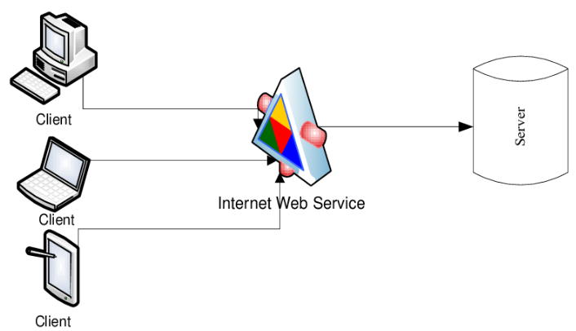
TCP/IP – Web Server (Client/Server)
Server on Cloud – AWS/Azure
Your Laptop

Slide 4

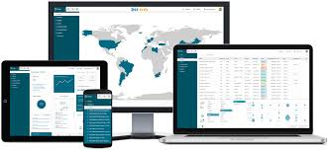
HTTP(S) Web Server (Client/Server)
AWS – EC2 Server
Apache
Web Server
Java Script
HTML
CSS
Bootstrap CSS
Python Flask as a
Web Server
Python
HTML
CSS
Bootstrap CSS
Your Laptop
Server on Cloud – AWS

Slide 5
HTTP(S) Web Server (Client/Server)
What is Web Server ?
It is a software Program that runs on a Physical Server (aka – computer)
It Serves HTML pages (files/images/audio/video etc.)
It Uses HTTP/HTTPS Protocol
AWS – EC2 Server
Apache
Web Server
Java Script
HTML
CSS
Bootstrap CSS
Python Flask as a
Web Server
Python
HTML
CSS
Bootstrap CSS
Your Laptop
Server on Cloud – AWS

Slide 6
AWS –EC2 Server Instance – Python Installation
sudo yum update -y
sudo yum install python3
sudo pip3 install flask
sudo pip3 install numpy

Slide 7
AWS –EC2 Server Instance – Your First Web Page
from flask import Flask, render_template, request
#### initialize the flask app.
app = Flask(__name__)
################################
# home page
################################
@app.route('/', methods=['GET', 'POST'])
@app.route('/home', methods=['GET', 'POST'])
def home():
return '<h1>Hello World</h1>'

Slide 8
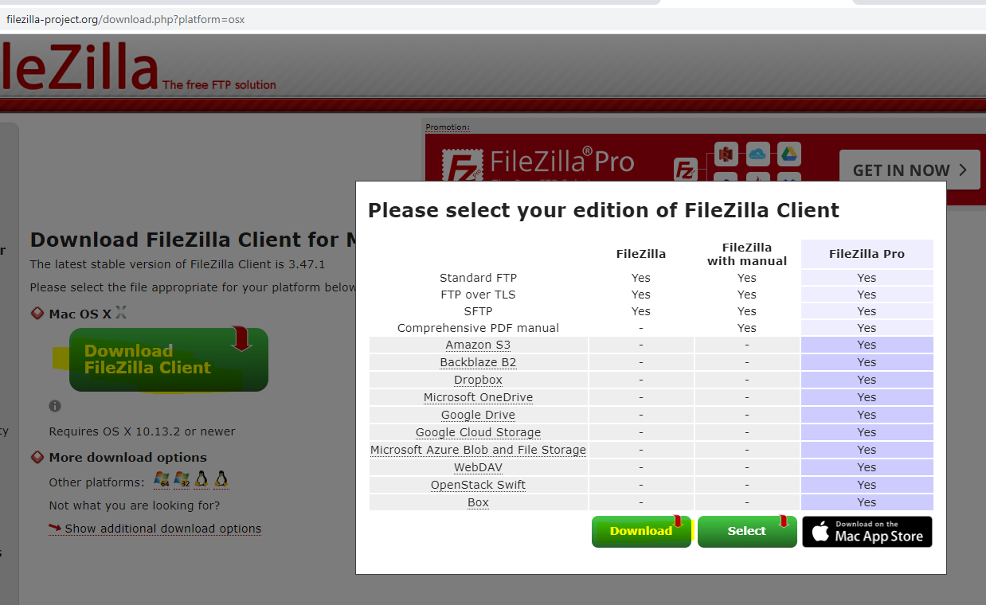
FTP Client Installation
https://filezilla-project.org/download.php?platform=osx

Slide 9
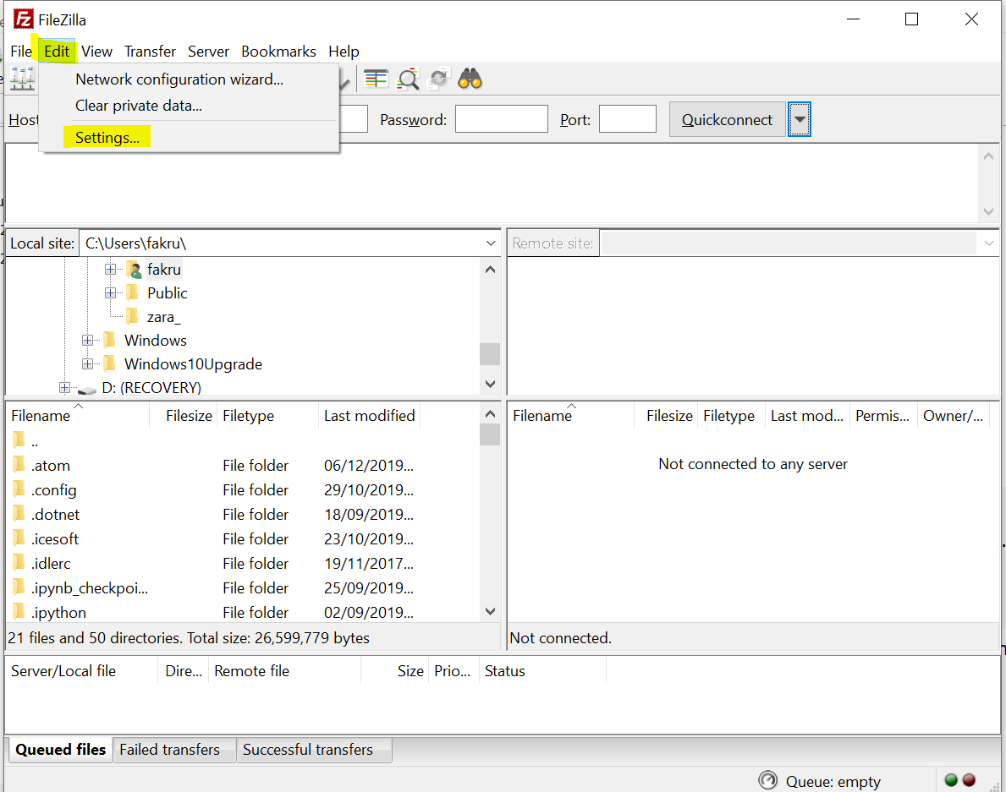
FTP Client Installation
https://filezilla-project.org/download.php?platform=osx

Slide 10
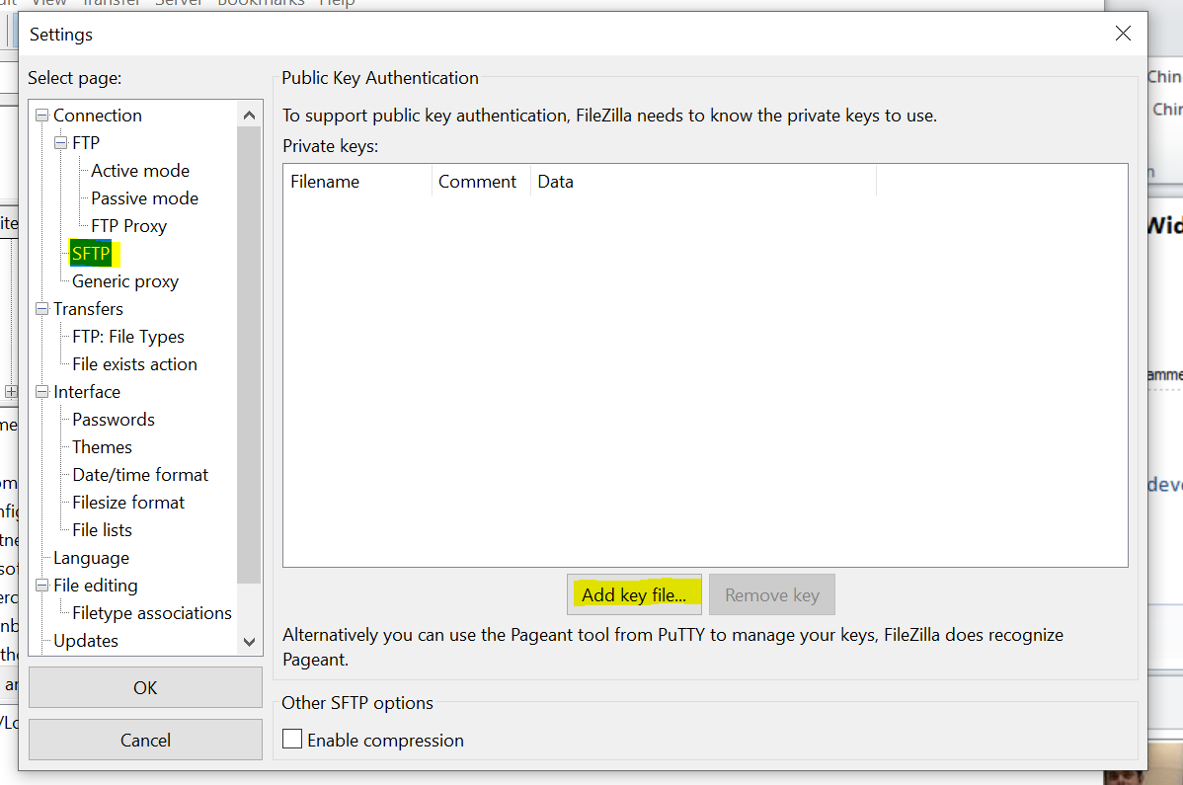
FTP Client Installation
https://filezilla-project.org/download.php?platform=osx

Slide 11
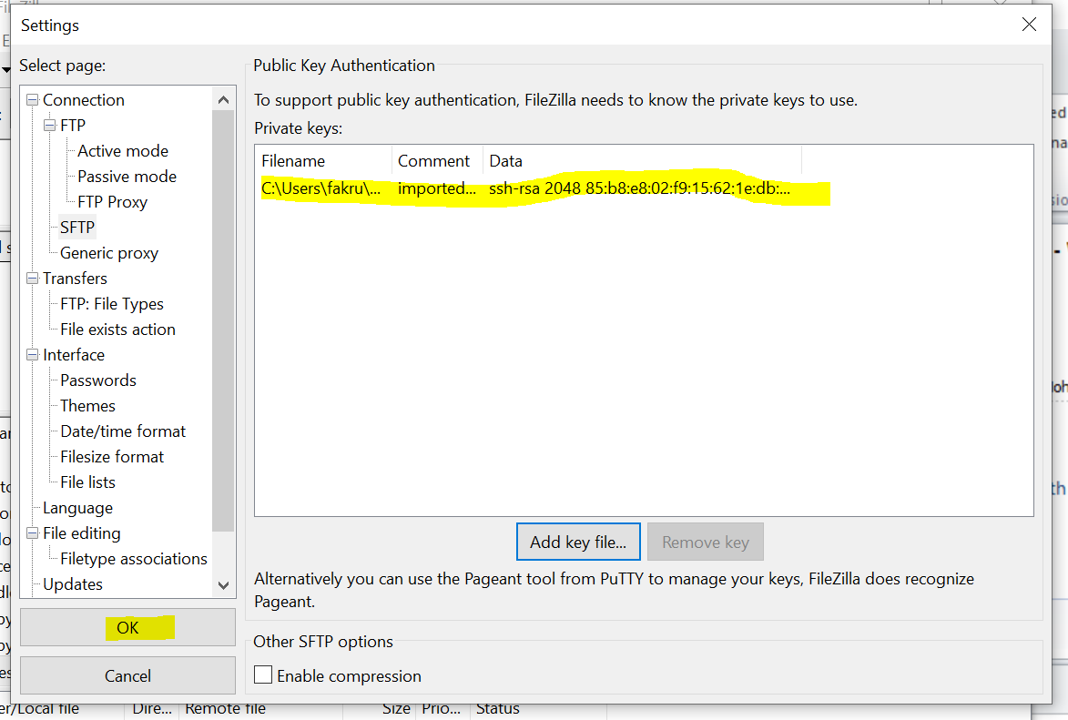
FTP Client Installation
https://filezilla-project.org/download.php?platform=osx

Slide 12
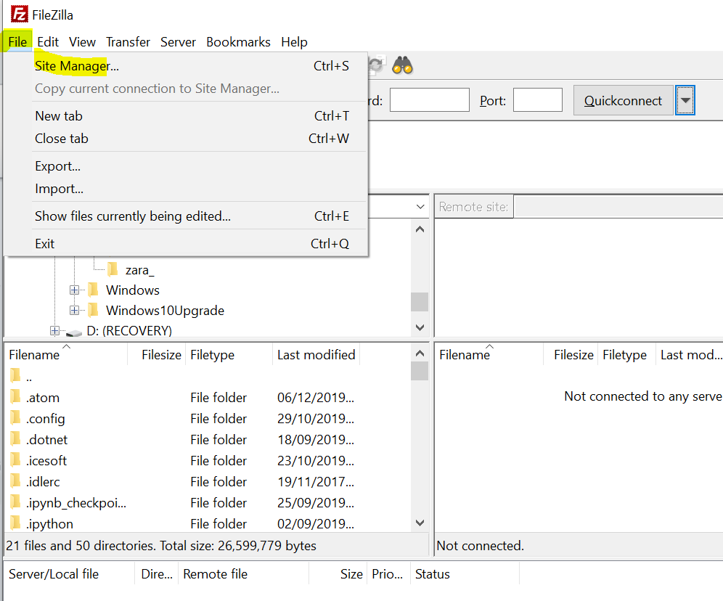
FTP Client Installation
https://filezilla-project.org/download.php?platform=osx

Slide 13
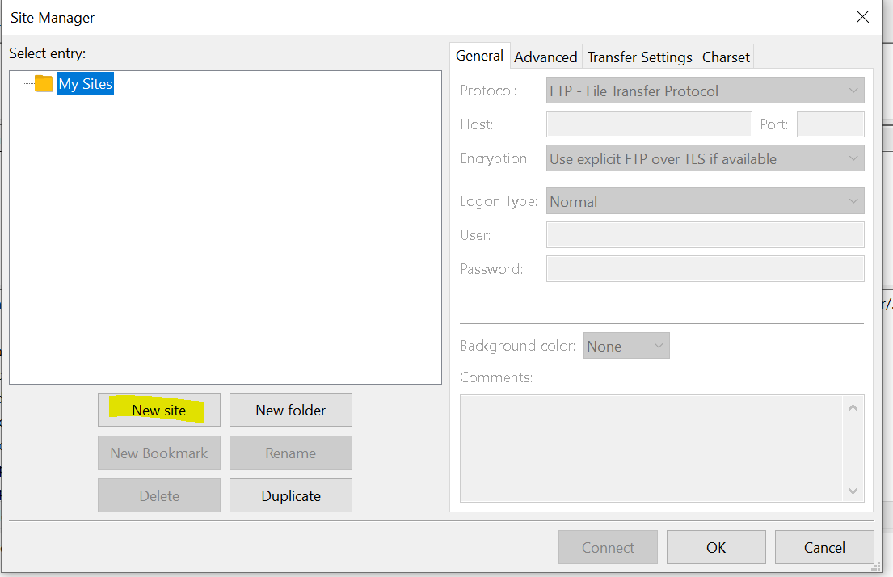
FTP Client Installation
https://filezilla-project.org/download.php?platform=osx

Slide 14
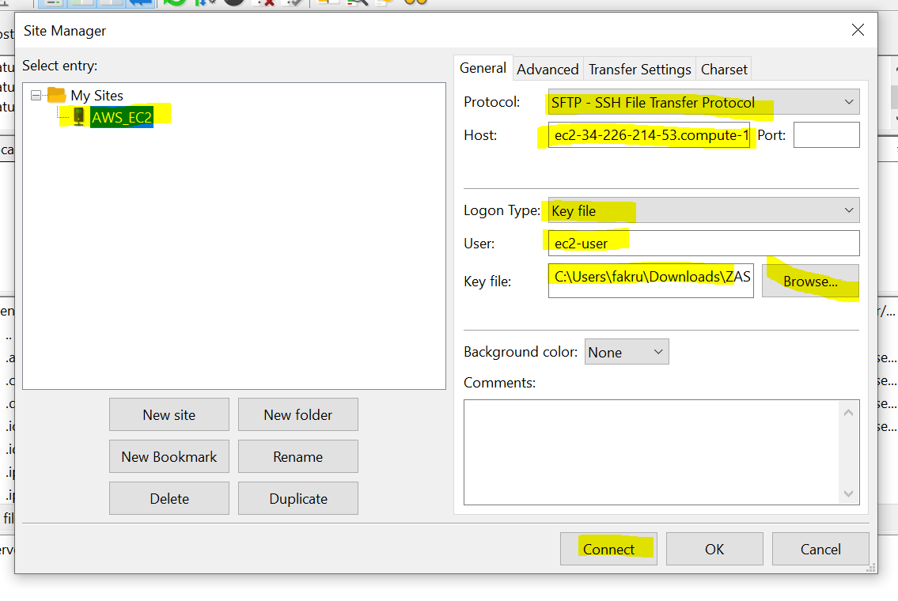
FTP Client Installation
https://filezilla-project.org/download.php?platform=osx

Slide 15
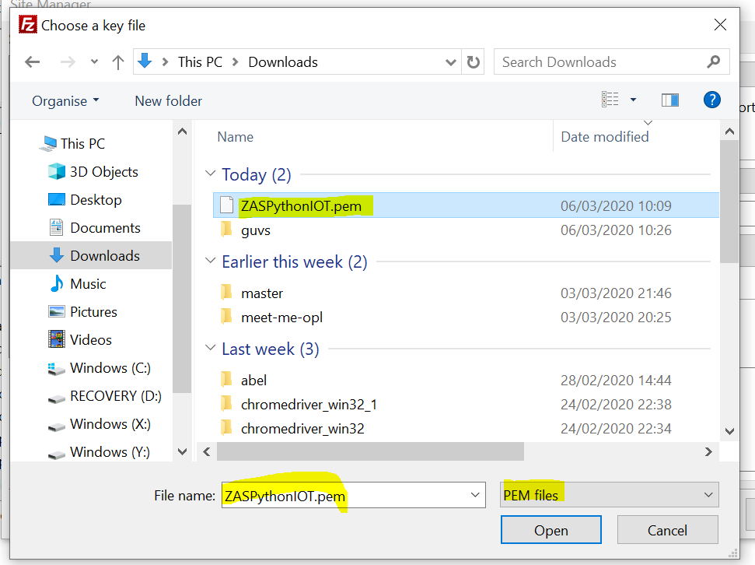
FTP Client Installation
https://filezilla-project.org/download.php?platform=osx

Slide 16
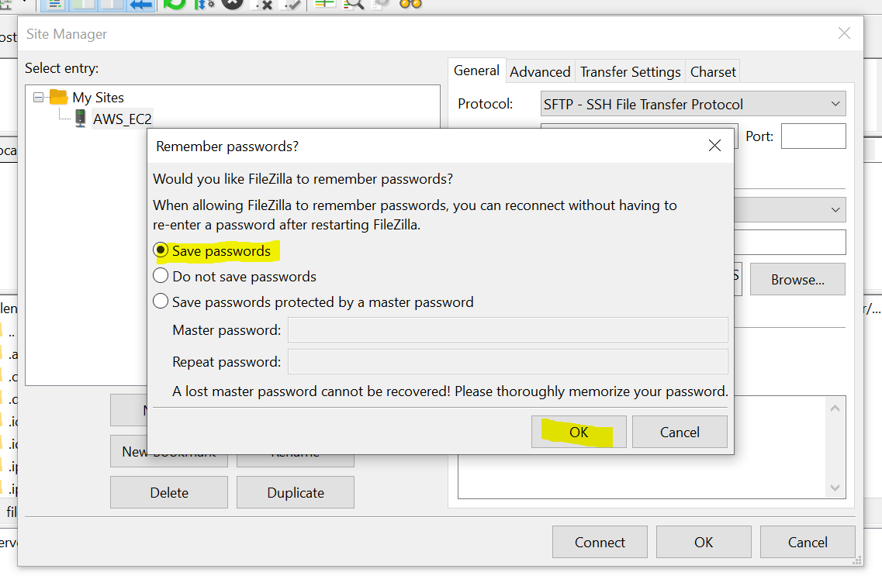
FTP Client Installation
https://filezilla-project.org/download.php?platform=osx

Slide 17
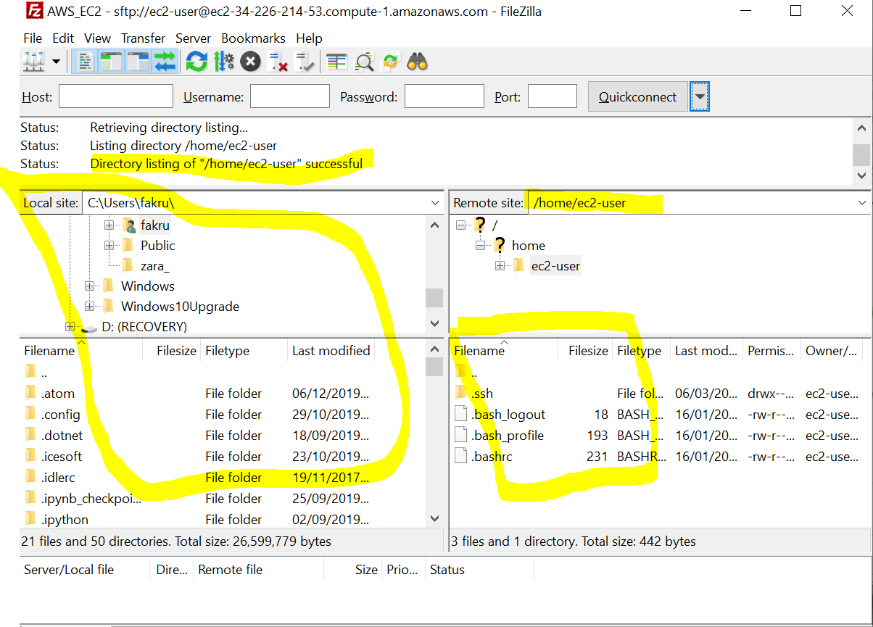
FTP Client Installation
https://filezilla-project.org/download.php?platform=osx

Slide 19
Appendix

Slide 20
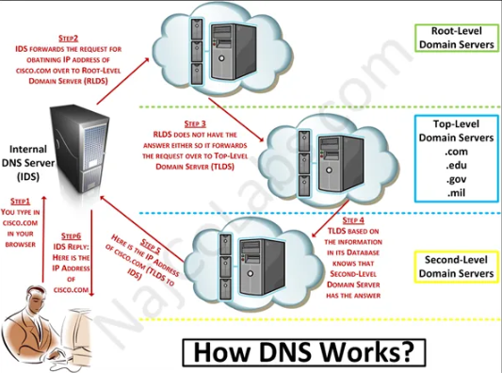
Cloud Computing at Home

